Slide 1
CL Module Tasks
UMAY
2019, March 11th
Notes:
I am working in HW Industrialization group. Responsible from the source part of sensing.
I recently joined ASML, had experience with high power lasers that are used in military applications.

Slide 2
Source Tasks
CL Module Tasks
LPPS Health Monitoring
Shutter Tasks
Notes:
So what are source components?
In this presentation:

Slide 3



CL Module (Continuous Lambda Module)
LPPS
Spectrometer
Mixing fiber
Y
H
Z
Cal. source
V
F1
F2
F3
F4
OPTICAL BASE FRAME
L1
L6
L5
≅ 4%
L4
M2
BS2
L2
L3
ND1
5x ND
1x open
3x spare
M1
≅4%
M3
BS1
LWP
SWP
ND2
MOTOR FRAME
Notes:
Helps us to pick the desired color from the wide white light spectrum
LPPS fiber brings the light in
Optics guide the white light to 2 filters. These filters let the photons that have desired/asked wavelength to pass through. So now after the XWP Assy (contains LWP and SWP) we actually have a color (not white light anymore)
4 percent of the colored light is guided to the spectrometer. It checks the intensity and the wavelength accuracy of the light. It is important component.
Calibration source is used by the calibration tasks for spectrometer which we will have a brief look later on.
The most part of the colored light is guided to ND filters and the light passes through those filter than is again guided to the output of the Cl module and finally to the CL to Shutter box fibers.

Slide 4
CL Module
CL Calibrations
Task Name | Task Number | Q-Tool
Calibrate Illumination Spectrometer Wavelength Coarse | 600 | 613
Calibrate Illumination Wavelength Home Offset | 605 | 605
Calibrate Illumination Spectrometer DC Offset | 604 | 616
Check Illumination Spectrometer DC Offset | 623 | 624
Calibrate Illumination Spectrometer Non-Linearity | 611 | 617
Calibrate Illumination Spectrometer Irradiations | 612 | 618
Calibrate Illumination Spectrometer Wavelength Fine | 619 | 620
Check Illumination Spectrometer Wavelength Fine | 626 | 627
Calibrate Illumination Encoder Position to Wavelength | 602 | 602
Check Illumination Encoder Position To Wavelength | 625 | 625
Calibrate Illumination ND Filter Position | 601 | 601
Calibrate Illumination Wavelength Offset | 603 | 603
Check Illumination CLM Spectral | 630 | 630
Check Illumination Spectrometer | 628 | 629
Integration Time Determination Coarse | 609 | 609
Integration Time Determination Fine
Notes:
CL module parts are very sensitive. They are not preadjusted and stay at the same position for long. They continuously change position, the filters and light.
To adjust them with a set of calibrations is needed for better accuracy and at the end better performance of the YS system.

Slide 5
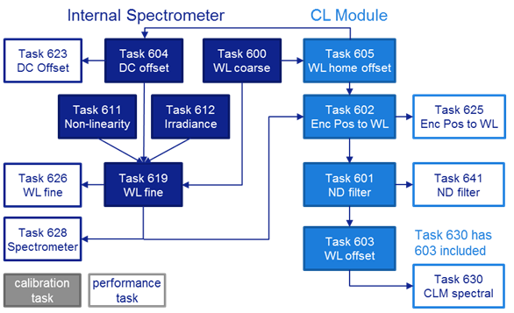
Dependency Overview

Slide 6
#600 – Calibrate Illumination Spectrometer Wavelength Coarse
Task Goal: To calibrate the spectrometer. This is not an actual calibration. This task copies the calibration data of the spectrometer EEPROM. It works as an initial calibration.
Reason for introduction: To improve the accuracy of the spectrometer measurements.
Effected Applications:
Procedure: fse145.cal (factory), fse237.cal (field), fse130.cal (3XX)
Task Run Time: 3 minutes
Task Type: Calibration
Destination: Factory and Field
Task Dependencies: None

Slide 7
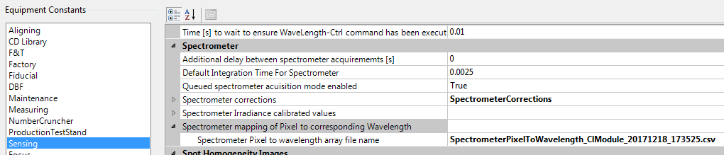
#600 – Calibrate Illumination Spectrometer Wavelength Coarse

Slide 8
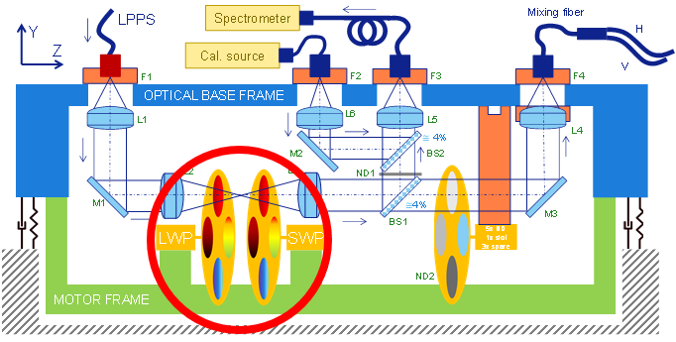
#605 – Calibrate Illumination Wavelength Home Offset
Goal Task: To calibrate the home offset of the LWP and SWP filter wheels
Reason for introduction: To improve the accuracy of the spectrometer measurements.
Effected Applications:
Procedure: fse146.cal
Task Run Time: 3 minutes
Task Type: Calibration
Destination: Factory and Field
Task Dependencies: 600
Notes:
- To calibrate the home positions of the color wheels. They have a set home point and this calibration makes it more accuracte.

Slide 9
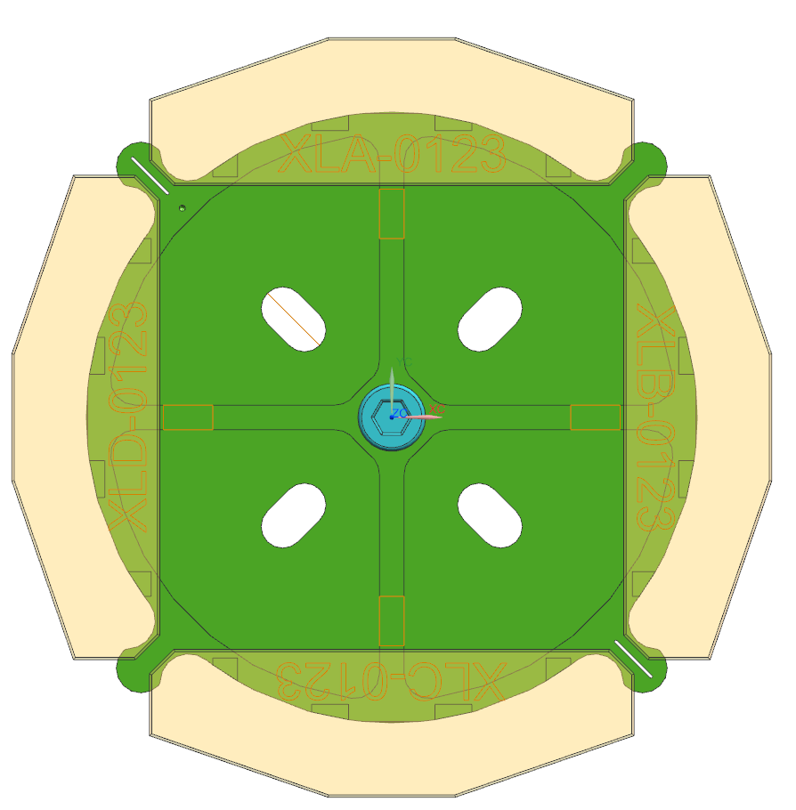
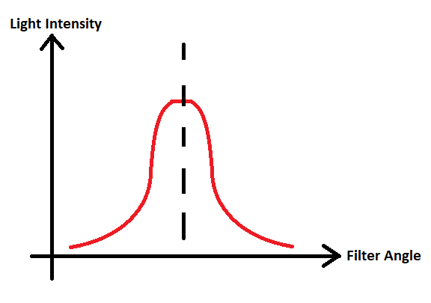
#605 – Calibrate Illumination Wavelength Home Offset
2mm
410nm
≅531nm
5mm
895nm
652.5nm
652.5nm
5mm
≅774nm
2mm
652.5nm

Slide 10
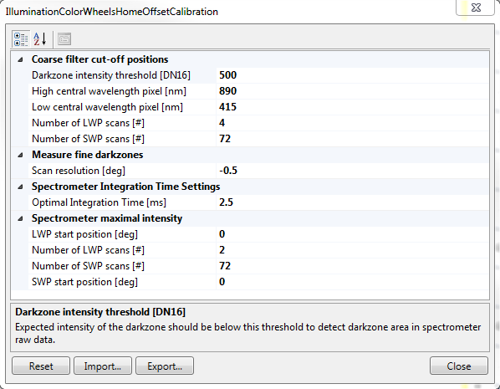
#605 – Calibrate Illumination Wavelength Home Offset
Hidden input: LwpScanRangeStep1 => Default 90 degrees
Can be set to 360 degrees to create a full IntensityMap.im file for diagnostics.
How to do this:
Press “Export…” to export inputs to xml file
Edit xml file and change LwpScanRangeStep1 from 90 to 360
Press “Import…” to import xml file
Change “Number of LWP scans” to define granularity of the scans over 360 degrees
Start task
D000538221-02-EDS_SW_IlluminationColorWheelsHomeOffsetCalibration.docx
D000533409-04-FSS_IlluminationColorWheelsHomeOffsetCalibration.pptx
Notes:
- To calibrate the home positions of the color wheels. They have a set home point and this calibration makes it more accuracte.

Slide 11
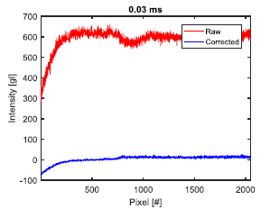
#604 – Calibrate Illumination Spectrometer DC Offset
Goal Task: To calibrate the spectrometer by diminishing the effects of unwanted noises, so that it is ready for more accurate further measurements. DC offset: Dark measurement extracted from actual measurement
Reason for introduction: To improve the accuracy of the spectrometer measurements.
Effected Applications:
Procedure: fse147.cal
Task Run Time: 3 minutes
Task Type: Calibration
Destination: Factory and Field
Task Dependencies: 605
Notes:
- DC offset can be caused by DC voltage, AC voltage, vibrations and temp changes. It is not a part of actual measurement so it should be excluded.
- We take the spectrometer readings with absolute no light. And later on extract these readings from actual light measurements. So we eliminate the noise.

Slide 12
#623 – Check Illumination Spectrometer DC Offset
Goal Task: To check if the DC offset calibration is done correctly
Reason for introduction: To improve the accuracy of the spectrometer measurements.
Effected Applications:
Procedure: fse469.per
Task Run Time: 3 minutes
Task Type: Performance
Destination: Factory and Field
Task Dependencies: 604
Notes:
- If there is some set value for the DC offset.

Slide 13
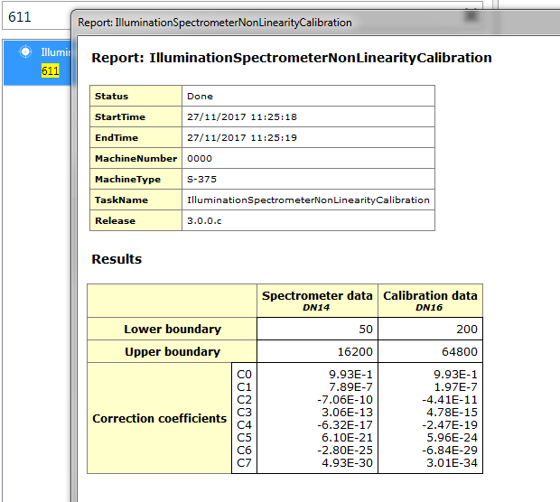
#611 – Calibrate Illumination Spectrometer Non-Linearity
Goal Task: To get the calibration values of the spectrometer for non-linearity from the EEPROM of the spectrometer
Reason for introduction: To improve the accuracy of the spectrometer measurements.
Effected Applications:
Procedure: fse148.cal
Task Run Time: 3 minutes
Task Type: Calibration
Destination: Factory and Field
Task Dependencies: None
Tip: If there are no values on this table, than the spectrometer was not calibrated.
Notes:
Non linearity: Calibrated before, written in EEPROM of the spectrometer. This calibration does only collect that data.
One tip
Non-linearity here is defined as the difference between pixels of spectrometer.

Slide 14
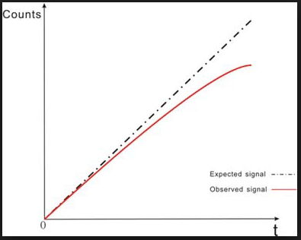
#611 – Calibrate Illumination Spectrometer Non-Linearity
Before
98,22%
After comp
99,78%
Notes:
Non linearity: Calibrated before, written in EEPROM of the spectrometer. This calibration does only collect that data.
One tip
Non-linearity here is defined as the difference between pixels of spectrometer.

Slide 15
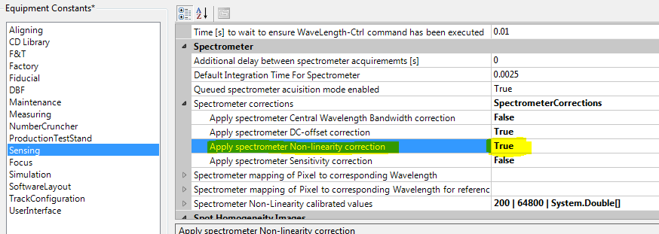
#611 – Calibrate Illumination Spectrometer Non-Linearity
Notes:
Non linearity: Calibrated before, written in EEPROM of the spectrometer. This calibration does only collect that data.
One tip
Non-linearity here is defined as the difference between pixels of spectrometer.

Slide 16
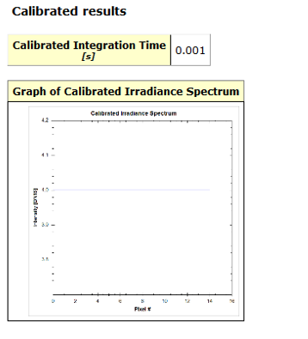
#612 – Calibrate Illumination Spectrometer Irradiations
Goal Task: To get the calibration values of the spectrometer for irradiance from the EEPROM of the spectrometer
Reason for introduction: To improve the accuracy of the spectrometer measurements.
Effected Applications:
Procedure: fse149.cal
Task Run Time: 1 minutes
Task Type: Calibration
Destination: Factory and Field
Task Dependencies: None
Notes:
Irradiance: Calibrated before, written in EEPROM of the spectrometer. This calibration does only collect that data.
One tip
Irradiance here is defined the amount of light certain pixels accept.

Slide 17
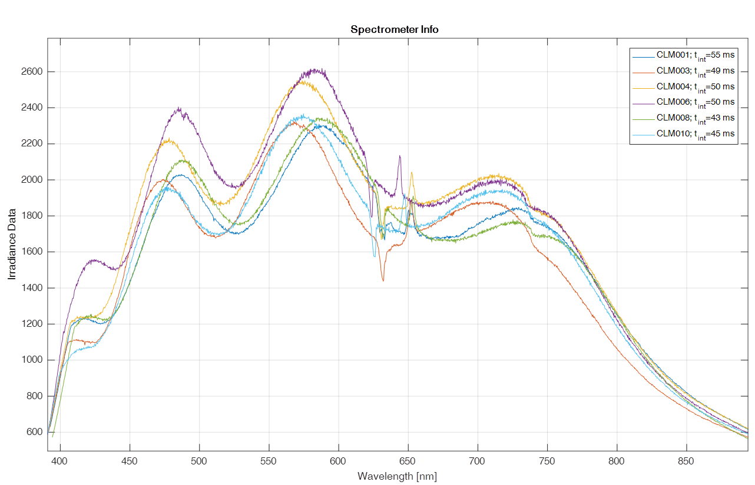
#612 – Calibrate Illumination Spectrometer Irradiations
Scattering of the edge of the 2nd order blocking filter
Notes:
Irradiance: Calibrated before, written in EEPROM of the spectrometer. This calibration does only collect that data.
One tip
Irradiance here is defined the amount of light certain pixels accept.

Slide 18
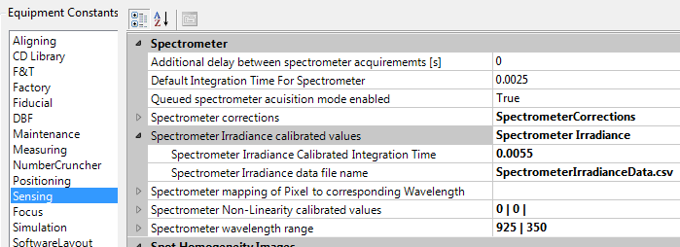
#612 – Calibrate Illumination Spectrometer Irradiations
Notes:
Irradiance: Calibrated before, written in EEPROM of the spectrometer. This calibration does only collect that data.
One tip
Irradiance here is defined the amount of light certain pixels accept.

Slide 19
#619 – Calibrate Illumination Spectrometer Wavelength Fine
Goal Task: To calibrate the internal spectrometer such that it gives more accurate wavelength measurements. The atomic lines are representing a certain WL and with this task a conversion to Pixel value is created. That is why we call this task “PixeltoWavelength Calibration”
Reason for introduction: To improve the accuracy of wavelength measurement done by internal spectrometer
Effected Applications:
Procedure: fse262.cal
Task Run Time: 20 minutes
Task Type: Calibration
Destination: Factory and Field
Task Dependencies: 600, 604, 611, 612
Notes:
It makes the spectrometer wavelength measurement much more efficient, accurate.

Slide 20
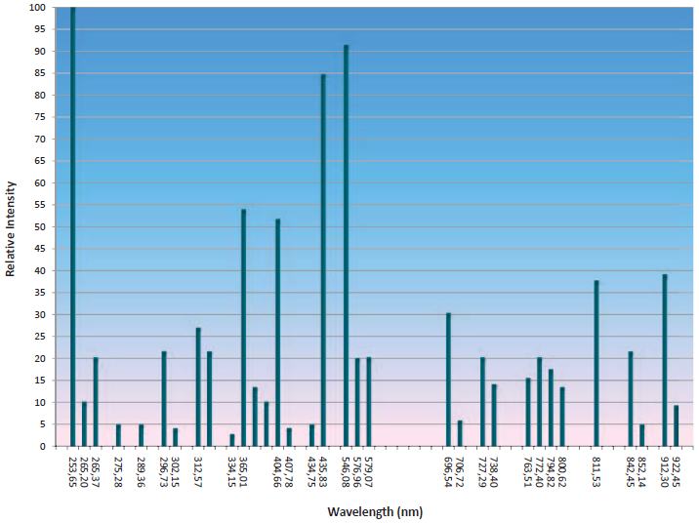
#619 – Calibrate Illumination Spectrometer Wavelength Fine
Atomic Lines of Calibration Source
Notes:
It makes the spectrometer wavelength measurement much more efficient, accurate.

Slide 21
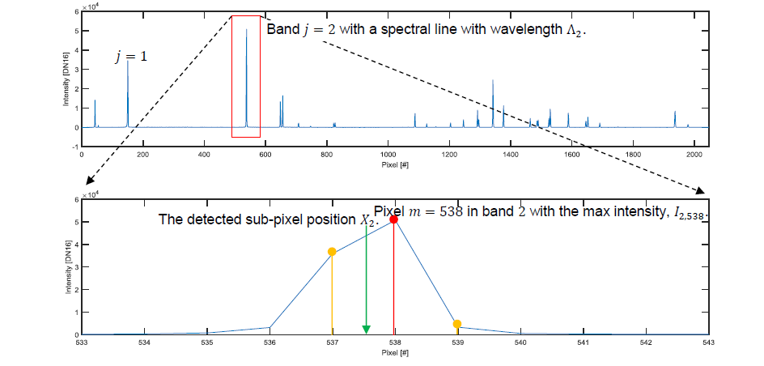
#619 – Calibrate Illumination Spectrometer Wavelength Fine
Notes:
It makes the spectrometer wavelength measurement much more efficient, accurate.

Slide 22
#626 – Check Illumination Spectrometer Wavelength Fine
Goal Task: To check if the the internal spectrometer is giving accurate measurements. This task is the check of “PixeltoWavelength Calibration”
Reason for introduction: To check the accuracy of wavelength measurement done by internal spectrometer
Effected Applications:
Procedure: fse470.per
Task Run Time: 20 minutes
Task Type: Performance
Destination: Factory and Field
Task Dependencies: 619

Slide 23
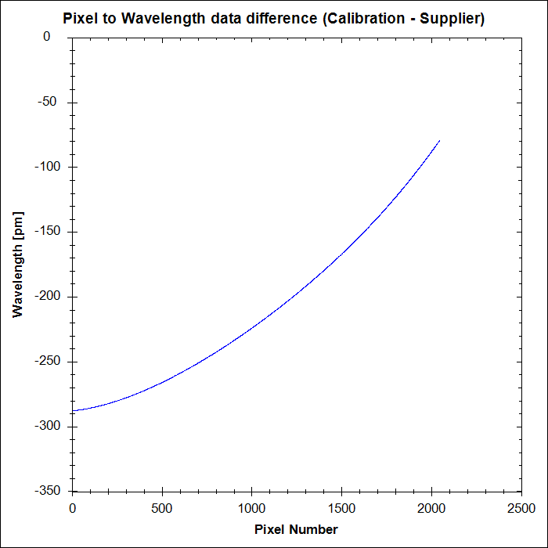
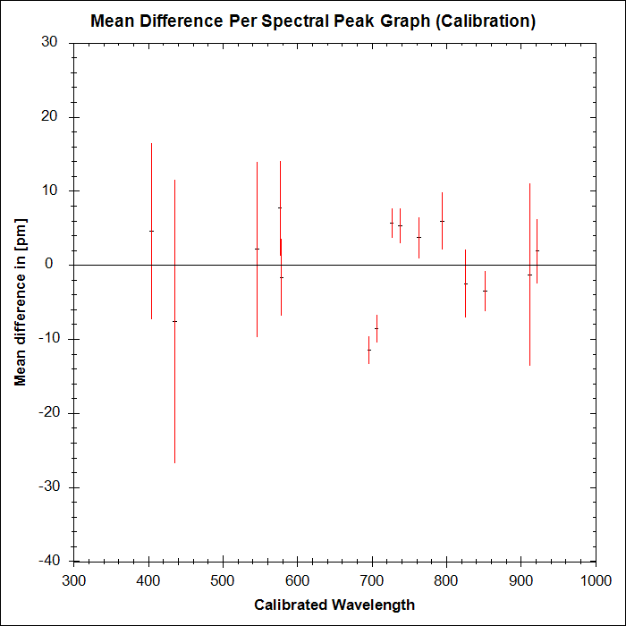
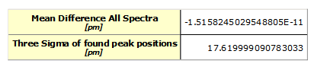
#626 – Check Illumination Spectrometer Wavelength Fine

Slide 24
#602 – Calibrate Illumination Encoder Position To Wavelength
Goal Task: To calibrate the filter wheel encoder positions
Reason for introduction: To be able to have a more accurate wavelength-bandwidth outcome from the CL Module
Effected Applications:
Procedure: fse150.cal
Task Run Time: 20 minutes
Task Type: Calibration
Destination: Factory and Field
Task Dependencies: 605, 619
Notes:
Color wheels have encoders to identify on which position they are. This position is very sensitive and needs to be calibrated. This calibration does that.
Each dots represent actually measured lights. Spots in between are interpolated (calculated)
The table should cover the white band, there should not be missing colors between 400-900 nm

Slide 25
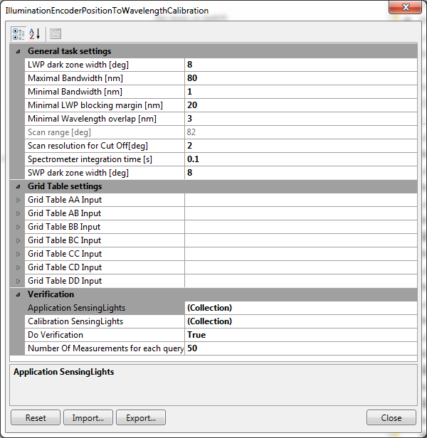
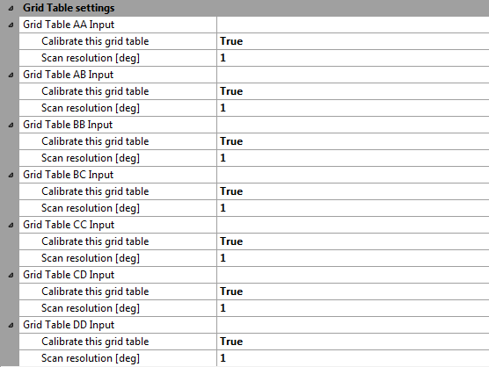
#602 – Calibrate Illumination Encoder Position To Wavelength
Notes:
Color wheels have encoders to identify on which position they are. This position is very sensitive and needs to be calibrated. This calibration does that.
Each dots represent actually measured lights. Spots in between are interpolated (calculated)
The table should cover the white band, there should not be missing colors between 400-900 nm

Slide 26
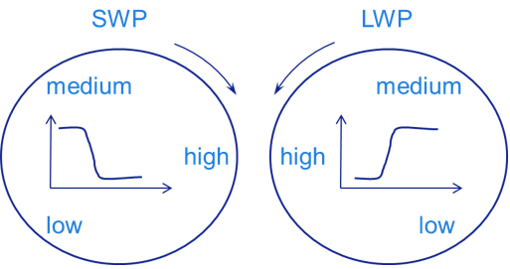
#625 – Check Illumination Encoder Position To Wavelength
Goal Task: To check if the wavelength filter positions are calibrated and correct.
Reason for introduction: To check if the calibration of filter wheels encoder positions was okay.
Effected Applications:
Procedure: fse471.per
Task Run Time: 1 minute
Task Type: Performance
Destination: Factory and Field
Task Dependencies: 602
Notes:
- Check for the previous calculation.

Slide 27
#625 – Check Illumination Encoder Position To Wavelength
Notes:
- Check for the previous calculation.

Slide 28
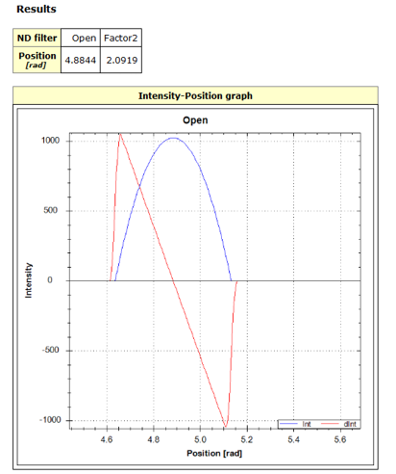
#601 – Calibrate Illumination ND Filter Position
Goal Task: To calibrate/determine the center positions of the ND filters on the ND filter wheel of the CL module
Reason for introduction: To improve the performance of ND filters
Effected Applications:
Procedure: fse151.cal
Task Run Time: 1 minute
Task Type: Calibration
Destination: Factory and Field
Task Dependencies: 602
Notes:
To calibrate the center position of the ND filters.
A certain amount of light is sent, the position we get the most light is the center of the filter.

Slide 29
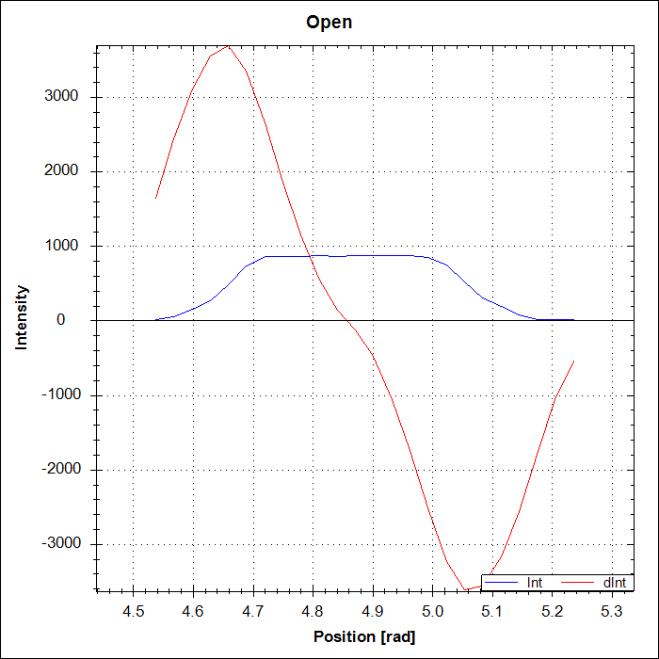
#601 – Calibrate Illumination ND Filter Position
Notes:
To calibrate the center position of the ND filters.
A certain amount of light is sent, the position we get the most light is the center of the filter.

Slide 30
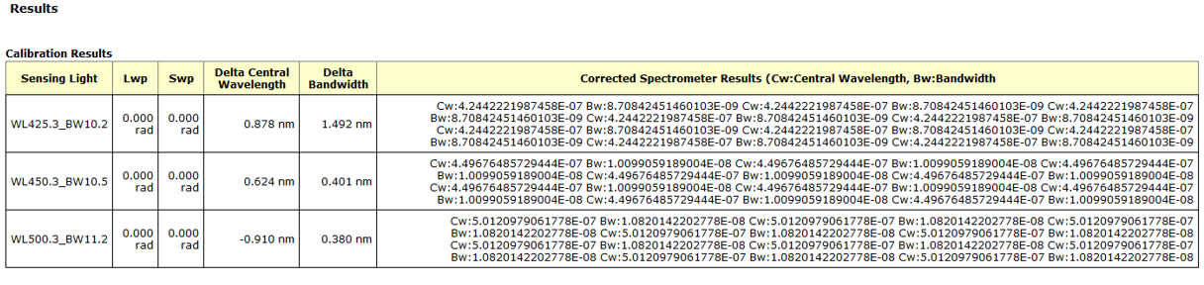
#603 – Calibrate Illumination Wavelength Offset
Goal Task: To calibrate/correct discrepancies that may have occurred because of post calibration drifts such as thermal or mechanical changes. Also to compensate for the imperfections in the interpolation algorithm.
Reason for introduction: To eliminate the drift caused by mechanical or thermal changes
Effected Applications:
Procedure: fse152.cal
Task Run Time: 3 minutes
Task Type: Calibration
Destination: Factory and Field
Task Dependencies: Task 601 and 602
Notes:
-

Slide 31
#630 – Check CLM Spectral Performance
Goal Task: To check the spectral performance of the Continuous Lambda Module which should be delivering the correct Wavelength with correct Bandwidth
Reason for introduction: To be able to check CLM performance
Effected Applications:
Procedure: fse472.per
Task Run Time: 2 minutes 30 seconds
Task Type: Performance
Destination: Factory and Field
Task Dependencies: 603 (603 is included in this task)
Can be run as an included (part of a task), inline (part of a job) or manual task.
Notes:
Checks if the spectrometer works correctly or not.
Calculates the differences of the selected CW (central wavelength) and BW (bandwidth), they should be within a spec in order to operate correctly.

Slide 32
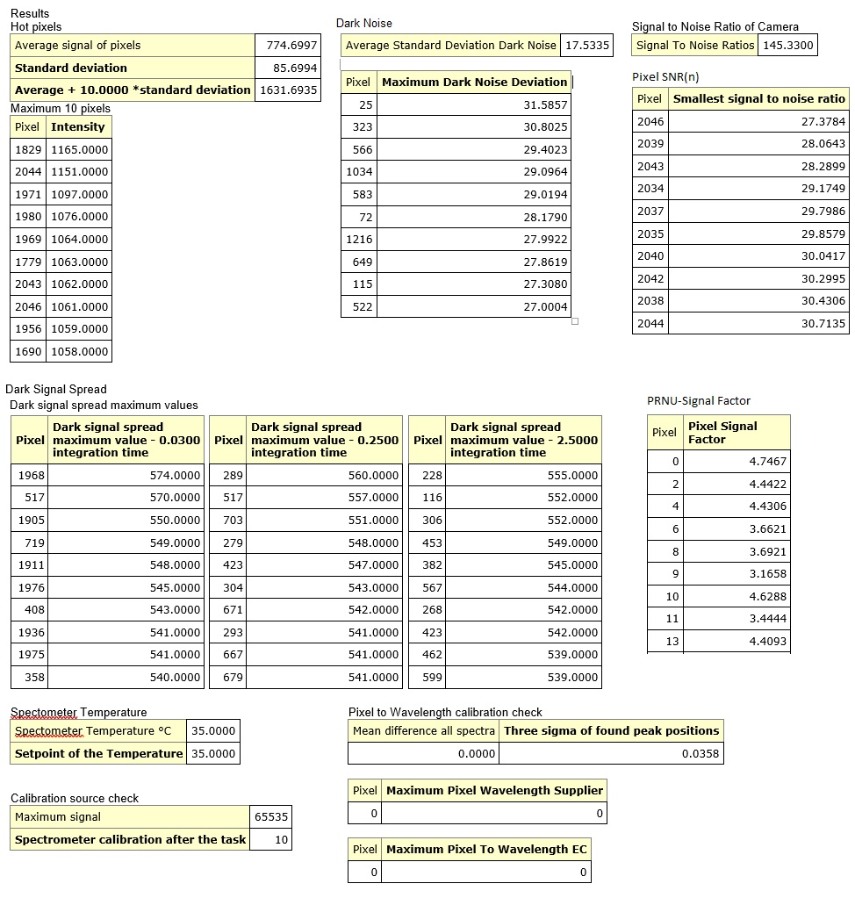
#628 – Check Illumination Spectrometer
Goal Task: To check if the internal spectrometer is working correctly
Reason for introduction: To be able to check spectrometer performance
Effected Applications:
Procedure: fse473.per
Task Run Time: 20 minutes
Task Type: Performance
Destination: Factory and Field
Task Dependencies: 619
Notes:
- Checks the spectrometers SNR, pixel intensities, temperature

Slide 33
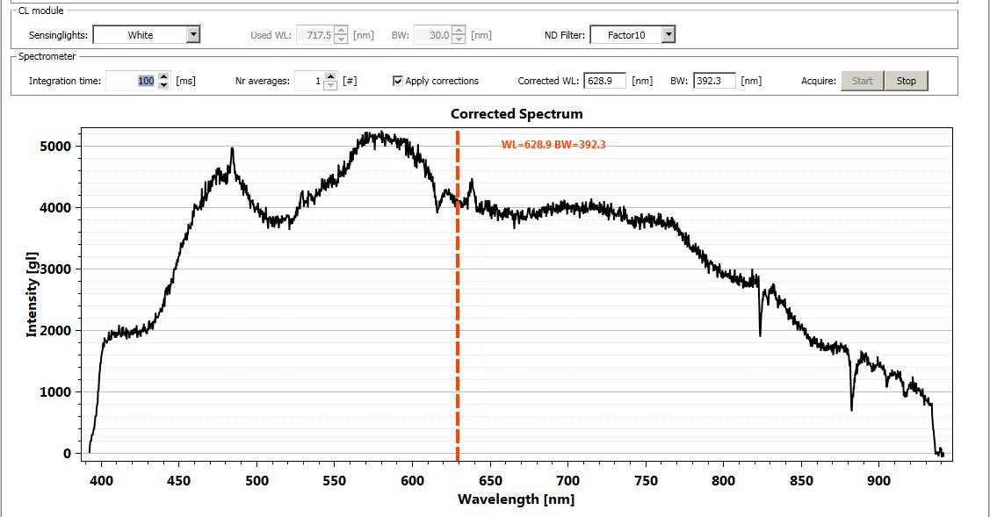
#609 – CL Module Dashboard

Slide 34
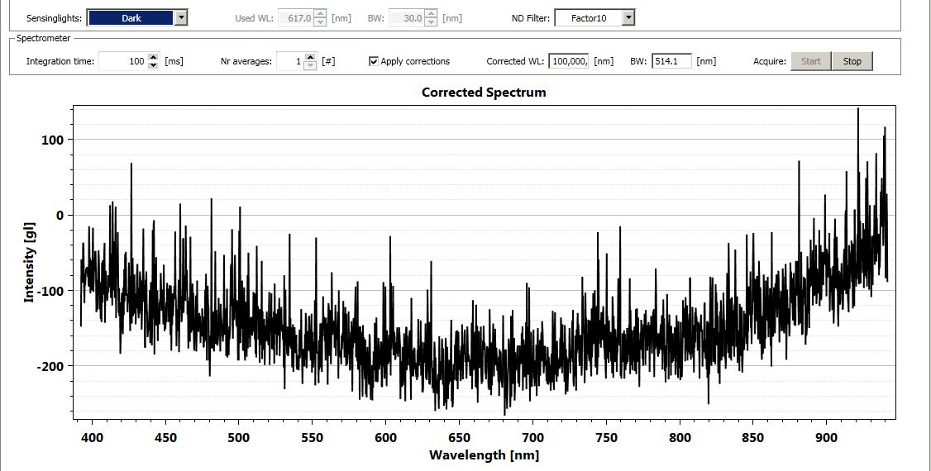
#609 – CL Module Dashboard

Slide 35
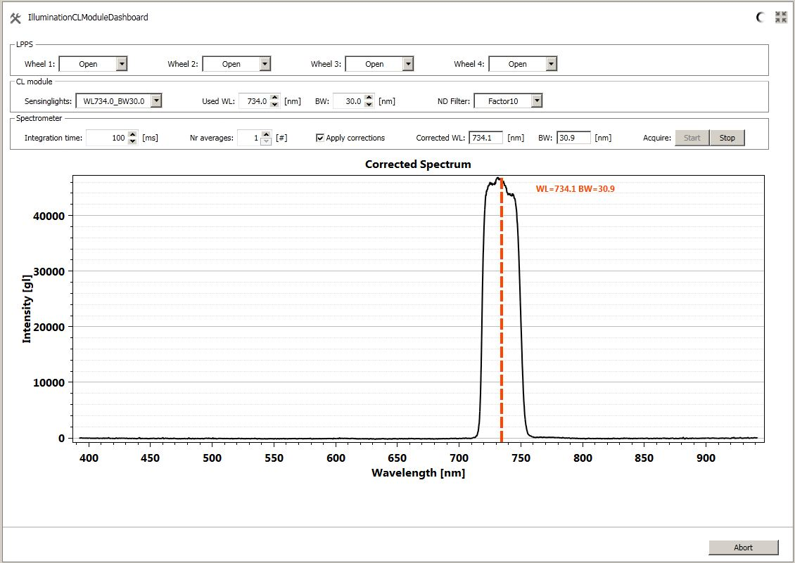
#609 – CL Module Dashboard

Slide 36
#628 – Check Illumination Spectrometer
Goal Task: To monitor the degradation of Light Source
Reason for introduction: There was no automatic monitoring of the LPPS
Effected Applications:
Procedure: -
Task Run Time: 20 minutes
Task Type: Performance
Destination: Factory and Field
Task Dependencies: 619
Notes:
- Checks the spectrometers SNR, pixel intensities, temperature

Slide 37
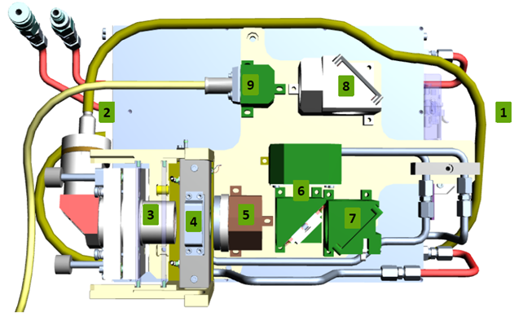
#654 – LPPS Health Monitoring
IR_Power Sensor
Lamp_On_Detect Voltage Sensor

Slide 38
#654 – LPPS Health Monitoring
Related ECs:
Lamp Module IR Laser Power Out Threshold (Different for MK3 and MK4!)
Default for MK3: 0.63
Default for MK4: 464 W
Lamp Module Lamp On Detect Threshold
Default: 3.75 V
Lamp warning up time: 1200 s

Slide 39
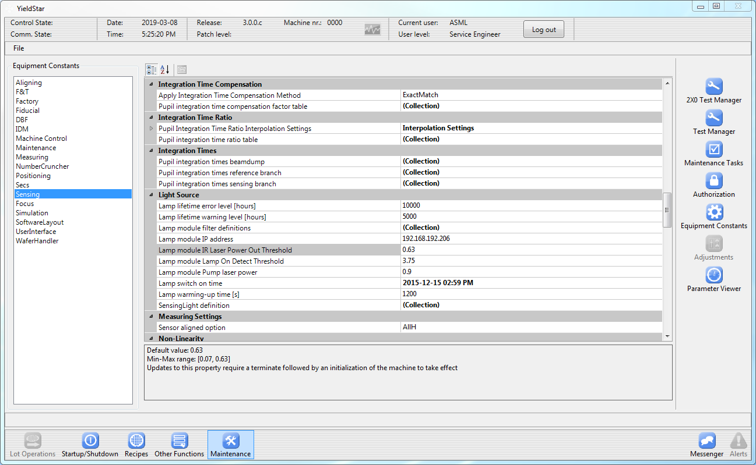
#654 – LPPS Health Monitoring

Slide 40
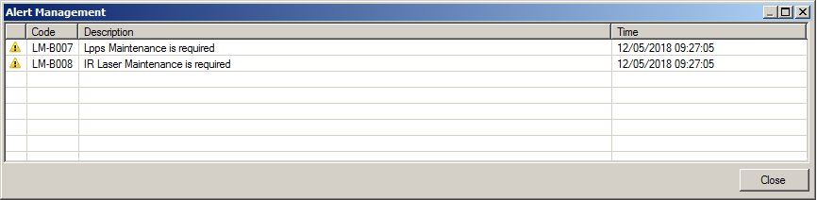
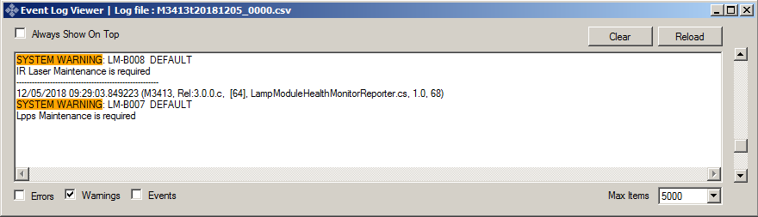
#654 – LPPS Health Monitoring
Reports will be for:
SECS, LANA (Litho InSight Analytics), Alarm Panel, Event Log

Slide 41
#402, 403, 25 and 123 – Shutter Box Tasks
#402, 403:
Updated regarding the camera change of 1375 w.r.t. 375 sensor.
For 1375, no relative intensity adjustment anymore, adjust to the maximum value. Camera compensates the differences.
#25, 123:
Currently not available for 1375 platforms -> trouble for determining the performance of shutter boxes on 1375 platforms. OCAP sections of this task have been updated and a new diagnostics method is added.
Update for 1375 platforms should be in SP20.

